Slide 1

Web Development Bootcamp
Here is where your journey begins
Organized By:
DSC NIT Jalandhar

Slide 2
CONTENTS OF THIS WORKSHOP
Front-end Development Workshop: Make some simple static websites on your own .
Get hands on wonderful resources
A Basic Project
Topics to be covered :- HTML, CSS , JavaScript etc.
Doubts Session And Discord Server.
Stick with us and come out in flying colors with a project of your own.

Slide 3
Day 1 Contents
01
Introduction To Web D.
02
History of HTML
03
04
The Project
HTML Tags and Semantics
Some insight about frontend and Backend Development
How the CSS, HTML5, JS came into being.
Working with tags and Understanding Semantics
About the project, working on it, Homework and Some Hints.

Slide 4
FRONT-END VS BACK-END DEVELOPMENT
Front-End Developer
How things look to the user
Involves: Images, Content and Structures.
HTML, CSS and JAVASCRIPT.
Back-End Developer
How Things Work?
Involves: “business logic” and data
Ruby, C++, PHP, Python, Java, .NET, Node Js, Objective C, etc.

Slide 5
INTRODUCTION
01.
HTML is the content part of the website.
02.
CSS is the styling of the website to make it look more beautiful.
03.
JavaScript adds Interactivity to a website.

Slide 6
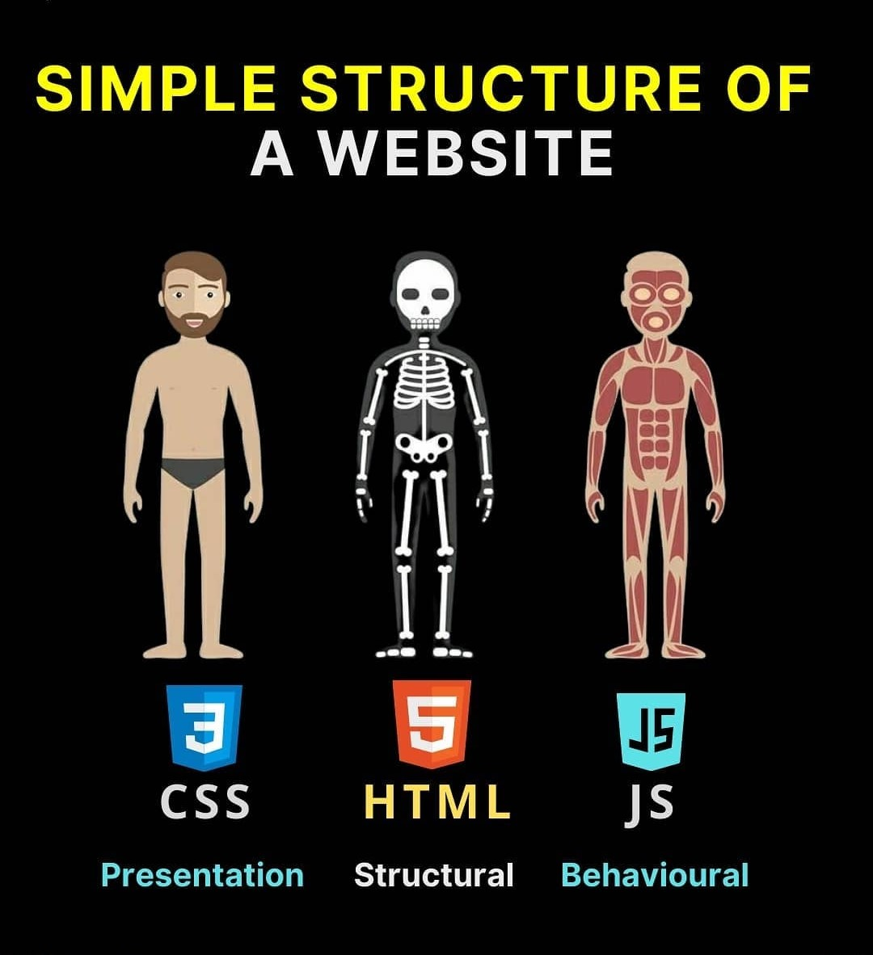
This Picture is worth a thousand Words

Slide 7
HISTORY OF HTML
HTML 1.0
HTML 2.0
HTML 3.0
HTML 4.01
HTML 5.0
01
02
03
04
05
Released in 1993 for sharing information
Published in 1995 with some additional features.
First time designed websites were released
The most used HTML version and most successful.
Extended version of HTML 4.01 and currently in use

Slide 8
Basic HTML Document
<!DOCTYPE html>
<html lang="en">
<head>
</head>
<body>
</body>
</html>

Slide 9

Head Tag
<head>
<meta charset="UTF-8">
<meta name="viewport" content="width=device-width,
initial-scale=1.0">
<title>Document</title>
</head>

Slide 10
HTML Text Elements
01
02
<hr>
03
<p>
<br>
04
05
06
<h1>-<h6>
<ul>,<ol>
<li>
Paragraph
Horizontal Rule
Line Break
Heading
Ordered and Unordered List
List Item

Slide 11
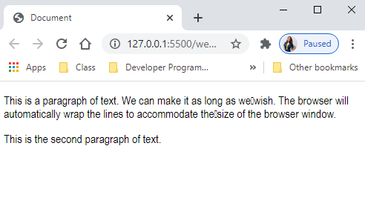
<body> <p>This is a paragraph of text. We can make it as long as we wish. The browser will automatically wrap the lines to accommodate the size of the browser window.</p> <p>This is the second paragraph of text.</p> </body>
Paragraph...

Slide 12
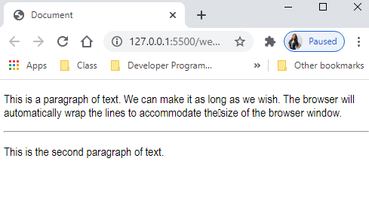
<body> <p>This is a paragraph of text. We can make it as long as we wish. The browser will automatically wrap the lines to accommodate the size of the browser window.</p> <hr /> <p>This is the second paragraph of text.</p> </body>
Horizontal Rule...

Slide 13
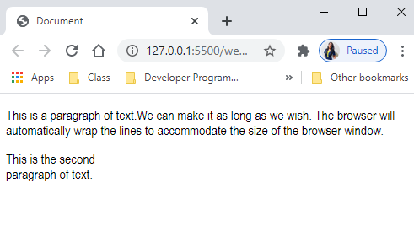
<body> <p>This is a paragraph of text.We can make it as long as we wish. The browser will automatically wrap the lines
to accommodate the size of the browser window.</p> <p>This i the second <br/> paragraph of text.</p> </body>
Line Break...

Slide 14
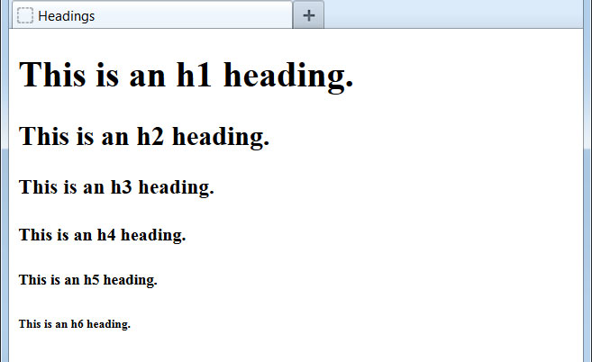
<h1>This is an h1 heading.</h1> <h2>This is an h2 heading.</h2> <h3>This is an h3 heading.</h3> <h4>This is an h4 heading.</h4> <h5>This is an h5 heading.</h5> <h6>This is an h6 heading.</h6>
Headings...

Slide 15

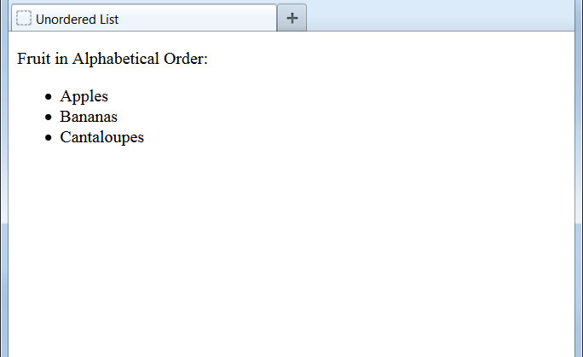
<p>Fruit in Alphabetical Order:</p> <ul> <li>Apples</li> <li>Bananas</li> <li>Cantaloupes</li> </ul>
Unordered List

Slide 16


<p>Fruit in Alphabetical Order:</p> <ol> <li>Apples</li> <li>Bananas</li> <li>Cantaloupes</li> </ol>
Ordered List...

Slide 17
<table> Tables
S.No. | Company Name | Products
1 | Amazon | Electronics Items
2 | Myntra | Beauty products
Table Heading
<th>
Rows <tr>
Individual Cell <td>

Slide 18
Syntax
<table>
<tr>
<th>S.No.</th>
<th>Company Name</th>
<th>Products</th>
</tr>
<tr>
<td>1</td>
<td>Amazon</td>
<td>Electronic Items</td>
</tr>
<tr>
<td>2</td>
<td>Myntra</td>
<td>Beauty Products</td>
</tr>
</table>
S.No. | Company Name | Products
1 | Amazon | Electronics Items
2 | Myntra | Beauty products

Slide 19
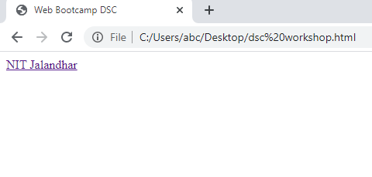
Links in HTML
<a href =“https://www.nitj.ac.in”> NIT Jalandhar </a>
Opening Tag
Page to Load
Text Displayed
Closing Tag

Slide 20
The <a> element ("anchor tag") is used to create a clickable link to another location.
The href attribute ("hypertext reference") instructs the browser which page to load if the link is clicked.

Slide 21

Images
<img src = “yukt.jpg" />
Image Tags are self closing.
The src attribute (source) supplies the name and extension of the image we want to display.
Make sure the image is in the same folder as html file.

Slide 22
Web Forms
Labels
Input Tag
Button
To specify what info user needs to enter.
Blank space for user to enter text.
Button to submit the form.

Slide 23
INPUT TAG
<input type=“text” placeholder=“Enter name”/>
They are used to create a blank space for user to enter info.
Input Tags are self closing.
Placeholder attribute contains grey text that tells user what to enter.
Type can be “email” , “text” etc , it checks whether the entered text is of the correct format.

Slide 24
Buttons
<button type =“submit”> Done </button>
Just change the type to “submit” in a button tag to create button.
Value b/w opening and closing tag specifies the text that will be displayed on the button.

Slide 25

Labels In Form
<label> Official Email id </label>
Label Tag is used before input tag to tell the user what he needs to enter.
It is not mandatory to use.

Slide 26
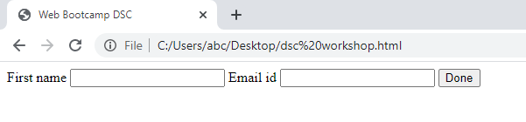
Form Syntax
<form>
<label>First name </label>
<input type=“text”/>
<label> Email id </label>
<input type=“email” />
<button type =“submit”>Done<button/>
</form>

Slide 27
Division Tag
<div>
<h1>Yukt </h1>
<p>He is Presenting</p>
</div>
It is used to divide the webpage into DIfferent sections.
Basically it is used to apply different CSS effects to different parts of the webpage.

Slide 28
Understanding Semantics
A Semantic Element clearly Describes its meaning to the browser and the developer.
Eg <form>, <table> and <article>
In Programming, Semantics offer a meaning to a line of code

Slide 29
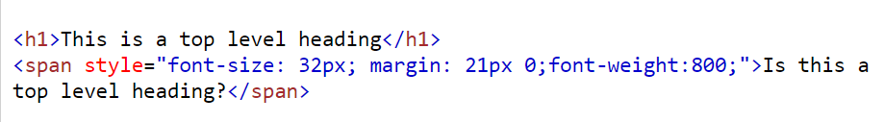
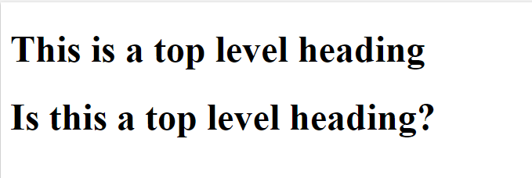
Clear Semantics

Slide 30
Some Semantic Elements
<header>
<section>
<footer>
Introductory content of the document.
Defines a section in a document.
Footer of the document.

Slide 31
Some Semantic Elements
<aside>
<article>
<nav>
Defines a section aside in a document like a sidebar.
Specifies independent self contained content.
Defines a set of navigation links.

Slide 32
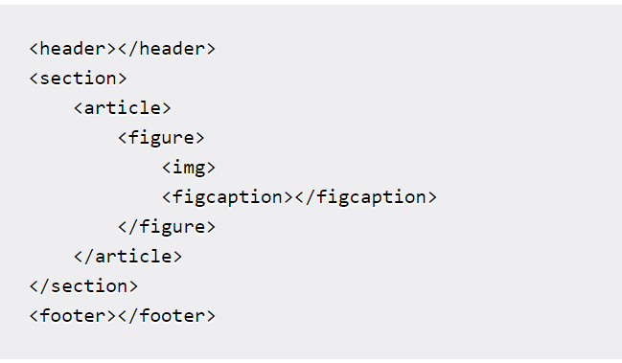
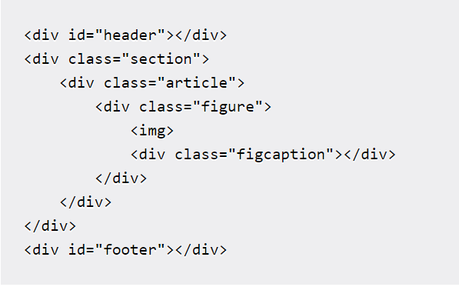
Which One Would You Choose?

Slide 33
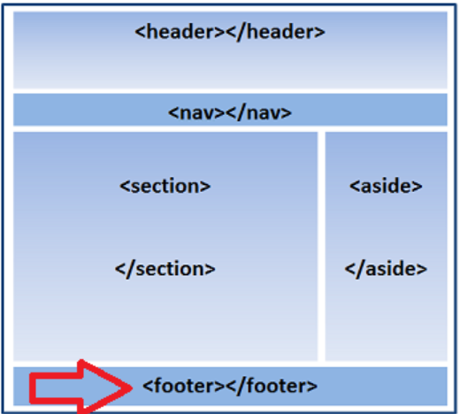
Semantic Sections

Slide 34
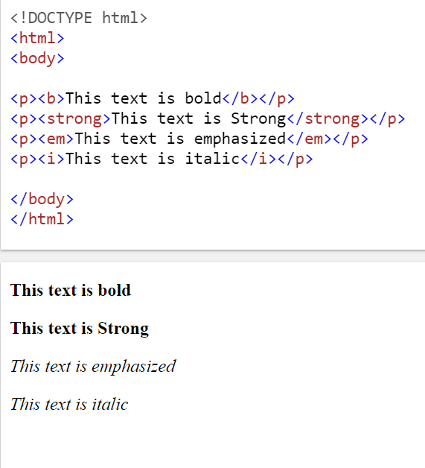
HTML Text Style Elements
01
02
<strong>
<b>
03
04
<em>
<i>
Bold Text
Important text
Italicized Text
Emphasized Text

Slide 35
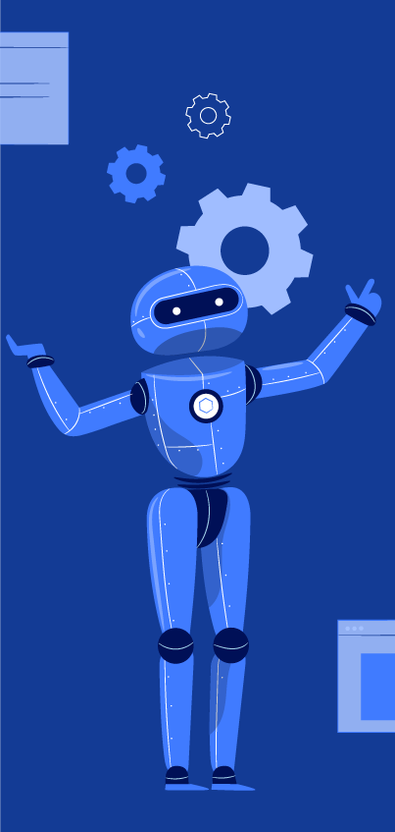
Project Time

Slide 36
Thanks
Do you have any queries?

